Slide 1

The Apache Software Foundation:
Community-Driven Global Innovation
Notes:
Hello! I'm Shane Curcuru, the Vice Chairman of the Apache Software Foundation, and I'm honored to speak with you today!
I'd like to give you a quick overview of Apache's accomplishments over the past twenty years, an introduction to how The Apache Way works to manage community-driven innovation, and how you might want to get involved with some of our many Apache projects.

Slide 2
ASF Mission
Provide software for the public good.
We provide services, support, and mentoring for hundreds of
software project communities.
Notes:
At our core, Apache's mission is simple: we provide software for the public good. Our model is to provide support - infrastructure, mentoring, governance - for our many Apache projects that create the software running much of the internet today. We provide this support so that our project communities can efficiently innovate new features, and maintain their software for the future.

Slide 3
Over 20 Years of Community-Led Development
“The Apache Software Foundation (ASF) is one of the most important and influential players in the modern open-source software development community.”
— Sean M. Kerner, eWeek
Notes:
Since our founding in 1999, Apache has grown to be one of the largest and most important groups in open source. Not only is Apache software used everywhere, but The Apache Way of how to manage community-led projects for long-term success has been copied by many other open source groups and projects. Most open source foundations echo many of the collaboration techniques that the ASF pioneered.

Slide 4

20 Years of Accomplishments
813 ASF Members
7,800+ Apache committers
200M+ lines of code in Apache repositories
Software value exceeding $20B (CoCoMo)
100% available to the public: zero cost and no licensing fees
Notes:
In the past 20 years, we've grown from 21 original founders of the Foundation to over 780 Apache Members - these are individuals who have stepped up to help build the long-term direction of the Foundation itself. And our committer base has grown steadily for the past twenty years to nearly eight thousand committers - these committers in Apache projects have published over 200 million lines of code, with a total value of well over twenty billion US Dollars.
And everything built by every Apache project is freely available - there is zero cost to using Apache software, and our permissive license ensures that you can freely innovate on top of our software to build anything you can imagine, with no restrictions or negotiations over the license.

Slide 5
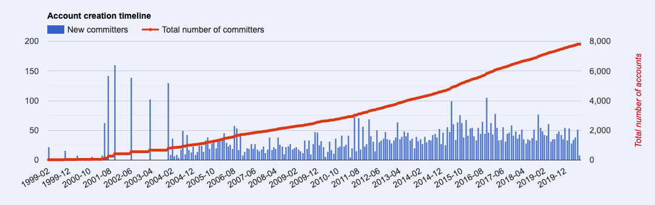
Consistent Growth
From 21 founders in 1999 to largest FOSS Foundation today with over 7,800 committers.
Notes:
We see here that the number of Apache committers - people who can submit work directly to Apache projects - has shown steady growth for twenty years, and continues to grow today.
Not shown on this chart is the growing number of contributors who have submitted patches or other work - there are tens of thousands of contributors to our projects, from everywhere in the world.

Slide 6
Apache Projects
350+ Apache project and sub-project communities
45 communities growing their projects in the Apache Incubator
Host core software across numerous categories: Big Data - Streaming - Messaging - Cloud Computing - AI and Machine Learning - Mobile - Internet of Things
Notes:
All of these contributors have helped build over three hundred and fifty Apache projects that are shipping code today to every country on the planet.
Plus, there are currently forty-five new communities, called podlings, in the Apache Incubator right now. These Incubator podlings are entire project communities being mentored at Apache, to grow their community into a sustainable and self-governing group.
The number of new Incubator podlings changes every week, with new communities joining, and existing communities showing their maturity and graduating to be a top level Apache project.

Slide 7
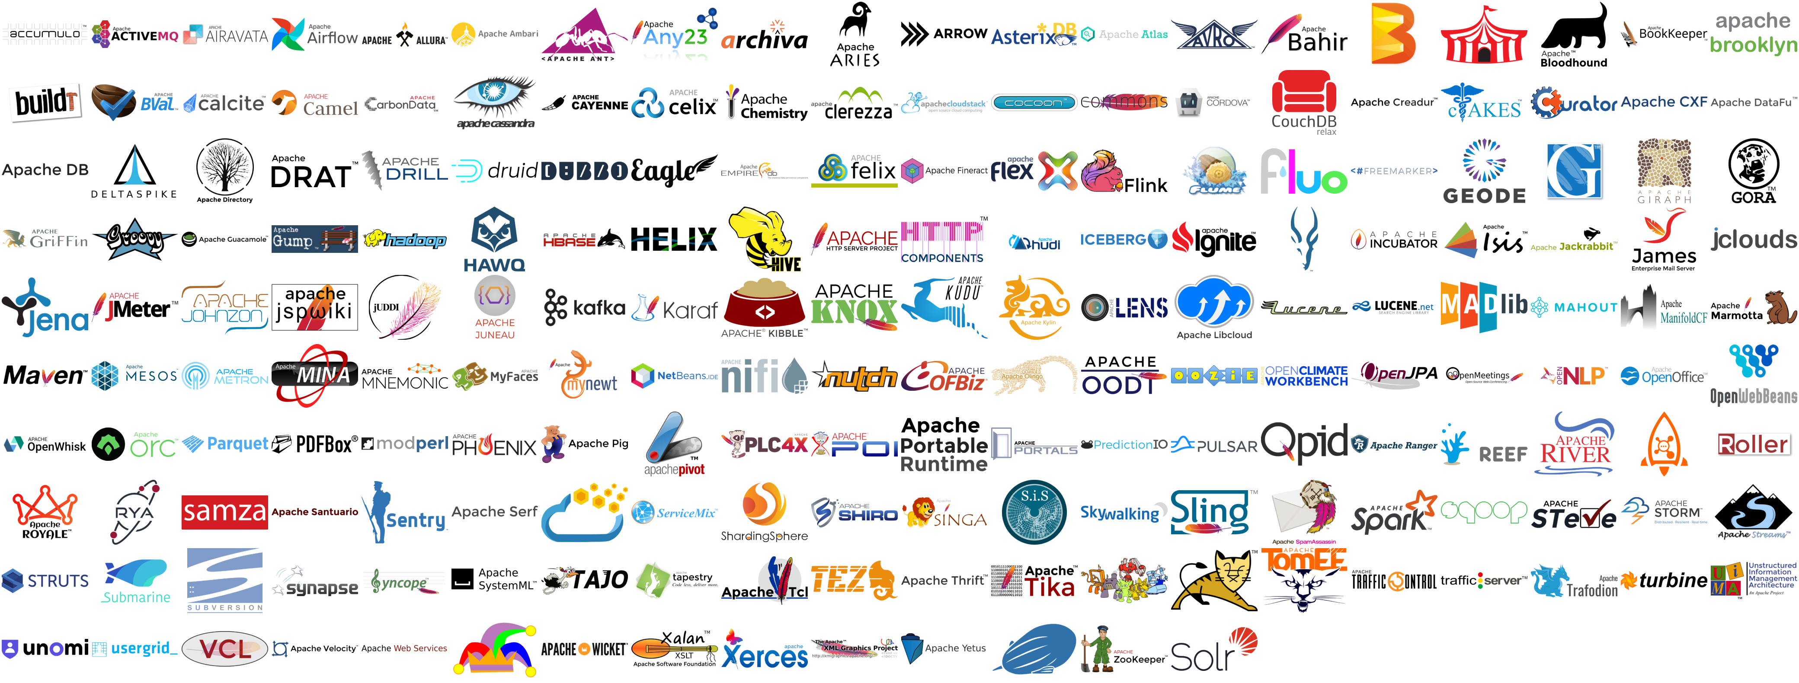
Apache Top Level Projects
Notes:
As you can see, we will soon need a bigger screen to display all the logos of Apache projects from around the world! Every one of these logos is an entire community shipping software today.

Slide 8
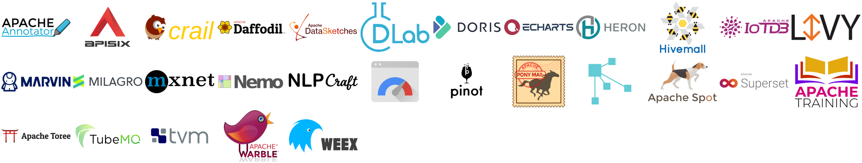
Apache Podlings In The Incubator
Notes:
And here are the 45 Apache Incubator podlings working on joining the ASF. Every podling here has experienced mentors and other support from the ASF working with them on project maturity and governance. New project communities approach the ASF all the time, seeking if Apache is the right space for them to grow, and the Incubator is here to help them on their journey.

Slide 9



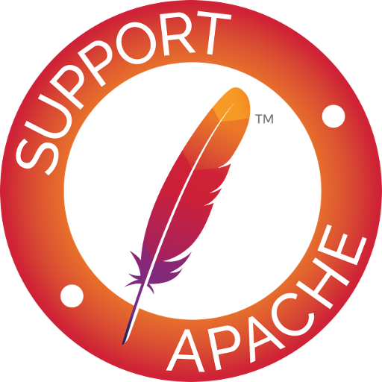
Modern Technologies Are At Apache
Apache projects dominate the Big Data ecosystem: Accumulo, Kylin, Flink, Ignite, Kafka, Pig, Spark, Eagle, Griffin
Cloud is native to Apache with Airavata, CloudStack, Hudi, Helix, Mesos, SkyWalking, and many more
AI & Machine Learning run with Spark, Mahout, Singa, MADLib, SystemML, MarvinAI
The ASF’s approach to governance and community-building allows a multi-billion dollar industry to form around our projects.
Notes:
And Apache isn't just web servers or Java - we host leading technology projects from almost every technology sector at Apache.
Apache Hadoop literally defined big data and created an industry - and now there are nearly fifty other Apache projects that provide key big data integrations.
CloudStack and a dozen other Apache projects build many key parts of the cloud native world.
And Apache Spark pioneered widely useable machine learning algorithms at Apache years ago, and the roster of AI and ML projects at Apache - many with key Chinese involvement - is growing rapidly.
Companies from multiple industries base their business on Apache projects, and that synergy - of companies freely building new solutions on top of our projects - is a key part of what makes Apache so successful.

Slide 10
Apache Global Impacts
Apache projects power more than half the Internet, managing over a billion gigabytes of data.
Apache software is inside nearly every user computing device from laptops to tablets to phones.
The commercially-friendly and permissive Apache License 2.0 is an industry standard within the Open Source world.
Notes:
When you consider the breadth of projects and technologies at Apache, software from the ASF powers more than half of the entire internet and it's data. In fact, the computer you're using right now to watch this presentation has multiple software products from Apache inside it, even if as a user you're not aware of all of them inside your browser and operating system.
Along with our vendor-neutral governance model, the well-known and highly permissive Apache 2.0 license ensures that everyone can build their own solutions on top of our software, without worrying about costs or negotiating licenses.

Slide 11
Every Internet-Connected Country
Notes:
Who downloads Apache software and who contributes to Apache? Here, you can see the key countries directly downloading or working on Apache projects in the past year - with China at the top of the chart.
Every internet connected country has users who have directly downloaded an Apache software product or who have contributed work to one of our projects.
The speed in which new communities and contributors from China are joining Apache projects is truly astonishing - and are very much welcome to help us innovate. It's exciting seeing how rapidly Chinese technologists and companies are embracing global open source techniques, and now helping to not just to build new projects, but improving how open source itself works.

Slide 12

Growing Leadership From China
Apache projects originating from China (10): CarbonData, Dubbo, Eagle, Griffin, HAWQ, Kylin, RocketMQ, ServiceComb, ShardingSphere, Skywalking
Apache podlings coming from China (9): APISIX, brpc, DolphinScheduler, Doris, ECharts, IotDB, MesaTEE, TubeMQ, Weex
Many Apache projects translated; Groovy, Cassandra, Flink all with large involvement from China
Notes:
The growth of entire new Apache projects coming from China is impressive, too. We currently have ten top level projects that originally came from China, several with very well-known names. And right now there are nine more Apache Incubator podlings from China working towards becoming top level projects. Importantly, these projects span the technology spectrum from big data, to streaming, to IOT, to everything touching cloud management. As for the rest of Apache projects, they are all looking forward to your contributions, and more and more projects are now working to provide website translations, or Chinese-language mailing lists for growing Chinese communities around their software.

Slide 13
How The ASF Works: The Apache Way
Our process is based on three concepts:
Earned Authority (Merit) — Individuals participate in Apache projects as individuals. They earn merit by what they do and how they do it.
Transparency — Our projects are developed and evolved in the open, so that everyone who wants to contribute is able to.
Community — We believe that great software is a property of great communities, and value community health over all else.
Notes:
Let's talk about how Apache works - how do we manage all these projects with contributors living around the world? Our method is called the Apache Way, and it relies on volunteers like you. We keep our project governance healthy by focusing on three things:
Earned Authority - the people in charge of project decisions are the ones doing the work. There is no top-down leadership from the ASF: every Apache project sets their own direction, and it's the people building the technology who decide the project direction.
All project decisions are made transparently, on open and archived mailing lists. And importantly, decisions are made over a period of time - at least 72 hours. Our entire communication model is focused on ensuring people from around the world, on different timezones or schedules, can all participate and lead in project governance.
And Apache is about Community Over Code. The real strength of any software project is not really the code you have today - it's where the community building that code can take it tomorrow. Apache is here to support and promote healthy project communities for the long haul.

Slide 14
How The ASF Works: The Apache Incubator
Entry path for project communities wishing to become part of the ASF family.
Ensures all code is in accordance with the ASF legal standards; mentors and teaches new communities in The Apache Way.
Infrastructure, communications, and decision-making must grow to be consistent with other successful ASF projects.
Not a reflection of the completeness or stability of the code; Incubation is a time of mentoring and community growth.
Notes:
How do we build strong communities? We have the Apache Incubator to mentor new projects. All new projects wishing to come to the ASF come to the Incubator first and become a podling.
In the Incubator, we have experienced mentors that will help you grow your community into the Apache Way. The Incubator provides advice on all aspects of building your open source project, like code, architecture, build tools - but the real goal of Incubation is to build a strong community that can govern itself, and can lead their own project to success in the long term.
The incubator also has strong protections for legal and IP processes in every new project. This ensures that end-users are secure in knowing they can safely and freely build their innovations on top of all Apache projects without fear of issues or surprises down the road.

Slide 15
How The ASF Works: Apache Attic
Complete lifecycle support for projects and communities.
Apache Attic keeps older projects code available read-only - never worry about mature or older projects getting deleted.
As a vendor-neutral non-profit organization, ensures that code donated to Apache projects will always be available.
Notes:
Here's another key value that Apache brings - full lifecycle support for open source. Not only do we actively mentor new projects and support existing ones, we also ensure that dormant projects are still available. There are plenty of software projects out there we all still use, even if they're not being actively developed. At Apache, you can be assured that all software released at the ASF will continue to be available forever, always free of cost and free to use for whatever purpose.

Slide 16
Why The ASF Works: The Result
Vendor Neutrality - We are a neutral meeting place for competitors to collaborate.
Diversity - Our model of governance lets projects evolve independently of corporate influence, and ensures they remain independent and diverse.
Trust - We are trusted by organizations around the world to serve as a home for their more important software projects.
Safety - Our governance model, intellectual property processes and licensing provide a safe environment for contributors and users alike.
Notes:
So what does the Apache Way bring to our projects? It brings vitality and longevity. All of these factors are important for innovating and maintaining a software project for the long term.
Our strong community governance enforces diversity and vendor neutrality, and builds upon it. Open Source innovation grows when more contributors join forces to solve a specific problem. Apache's licensing and governance model ensure that projects are welcoming to all, which draws in more contributors. This speeds innovation inside Apache projects, while always allowing you to build your own solutions on top of our software.
Using software from an Apache project means never having to worry about what some other company might do with the technology - because there's a broad community inside every Apache project that is setting the direction, never an outside company. Harmonious communities build prosperous software.

Slide 17
Why The ASF Works: Contributor Value
Contributions by individuals, not organizations
All-volunteer community (even if your employer pays you to work on Apache projects)
ASF does NOT pay for development
Not just code: contributions in documentation, project management, community, evangelism, user experience, organizing events, design, and more!
Notes:
What does this mean for you? You don't need to work for a big company or have a whole project to bring - Apache wants individual contributions too! Apache communities value you based on the actual contributions you bring to their project - not where you're from or who you work for. While the news stories may be about the big projects being donated, the real excitement is in meeting the community in a project, and being recognized individually for your work, and being voted in as a committer.
A key factor is that while you may contribute code as part of your job, here at Apache you as an individual get the credit for your work. Working on Apache projects is a great way to build your own reputation along with building great software, as well as getting to work directly with other contributors from around the world. The recognition you gain at Apache projects is something you can always be proud of.

Slide 18
Where Is The ASF Going?
Planning for long-term sustainability:
5-year Strategic Plan https://www.apache.org/board/plan
Solid Financial Standing https://www.apache.org/foundation/reports
Diversity & Inclusion -- recent major initiative https://diversity.apache.org/
Notes:
So what does all this longevity mean for the Apache Software Foundation as a whole? We're doing great, and we are actively planning for the long term. The board continues to work on our five year strategic plan, so that we can continue to adapt and innovate our community-based governance model and the Apache Way to be truly global -- and to face the new challenges that new technologies and open source methods bring.
Even in today's turbulent world, our non-profit financial picture is doing well, and we continue to have a strong and secure budget for core infrastructure funding.
And while our projects are always welcoming your contributions, we have recently launched a new Diversity and Inclusion program which is helping our projects better support new contributors from all cultures, languages, and backgrounds.

Slide 19
Get Involved!
Use Apache Projects - you already are!
Join your favorite Apache project mailing lists dev@ or user@ (projectname.apache.org)
Help develop Projects and Communities in “The Apache Way” https://incubator.apache.org/
Attend Apache Global Events - ApacheCon @ Home https://www.apachecon.com/
Apache Community Development - Help For Newcomers https://community.apache.org/
Notes:
So this is really the most important slide - how can YOU get involved at Apache?
The Apache Way is all about what you want to build, not about having a project plan define everything. The trick is to find projects that interest you - either new technologies you want to learn, or to help solve problems you're already facing. The hardest part is finding the right place to start - and we have people willing to help, both on our project mailing lists, and in our Community Development project that's here to direct you to the right place. Once you get started, it gets easier!
Also, we've recently announced ApacheCon At Home this year - our annual developer conference on all Apache projects will be fully virtual this year, and is free to register. This September you will be able to watch the whole conference online, and participate in active chats about projects, talks and tracks at the conference - please do check it out!

Slide 20
Thank YOU!
Shane Curcuru
Vice Chairman
Apache Software Foundation
Notes:
Thank you for this opportunity to share the Apache Way with you, and thank you to everyone working in Apache project communities!

